Slide 1

Data Analysis
Project - Velib
Doan-Kien THAI, Jonas MELANDSOR, Elsa DANH-NGHET
Group 12, 4MA, 2024
Notes:
Elsa

Slide 2
Table of contents
01
02
03
04
05
Introduction to the data
Principal component analysis
Clustering
Multiple correspondence analysis
Conclusion
Notes:
Elsa

Slide 3
01
Introduction
To the data

Slide 4
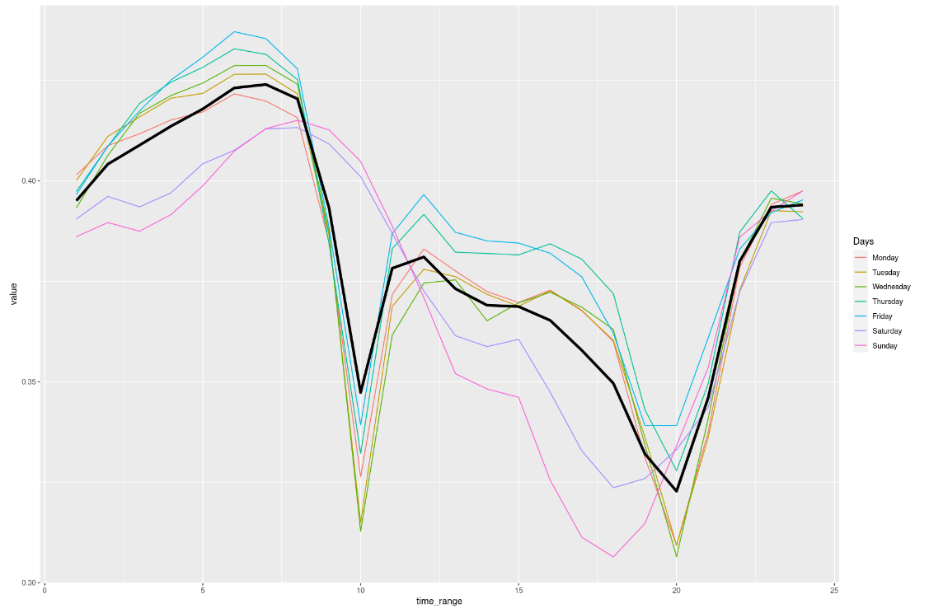
General observation
Least loaded station on average : Hornet (Bagnolet), 0.0161
Fullest loaded station on average : Insurrection aout 1944 (Ivry), 0.9194
Repeating pattern
Notes:
kien

Slide 5
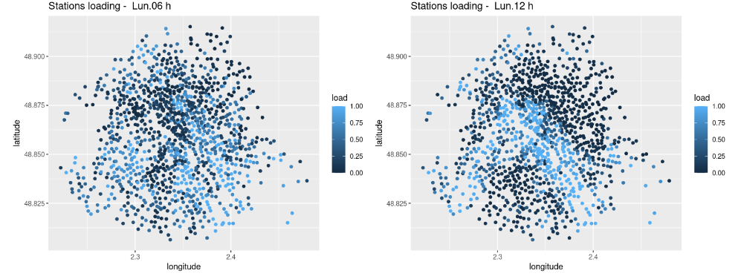
Loading of the stations in Paris
Monday, 6am
Monday, 12am
Notes:
kien

Slide 6
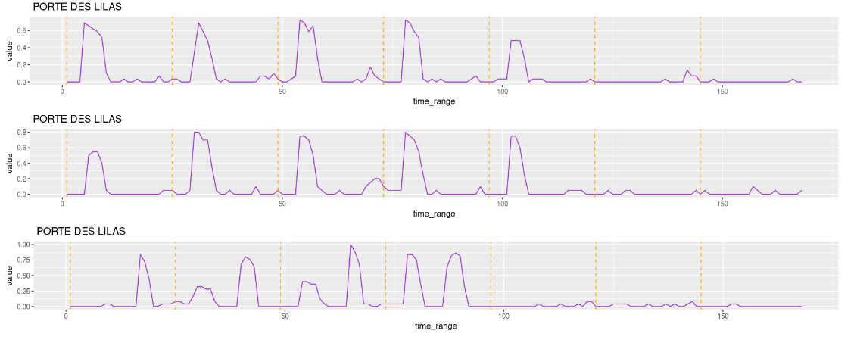
Multiple occurrences
Porte des lilas
Clichy
Average loading of Clichy: 0.0997
Average loading : 0.3816
Notes:
elsa

Slide 7
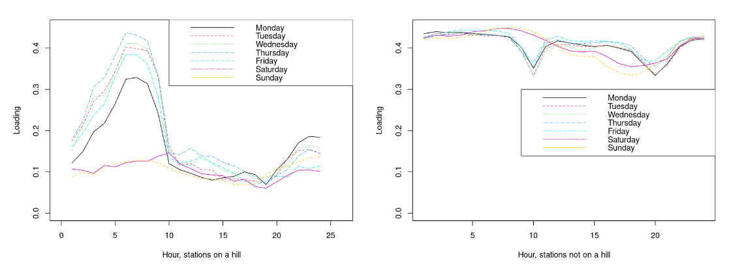
Impact of being on a hill
Notes:
elsa

Slide 8
Principal Component Analysis
02
Notes:
Jonas

Slide 9
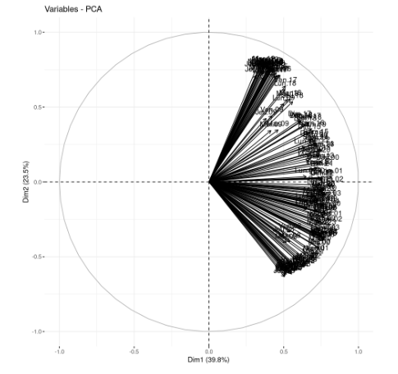
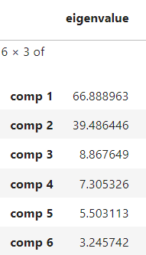
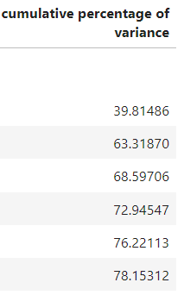
Choice of the number of components
Notes:
Jonas

Slide 10
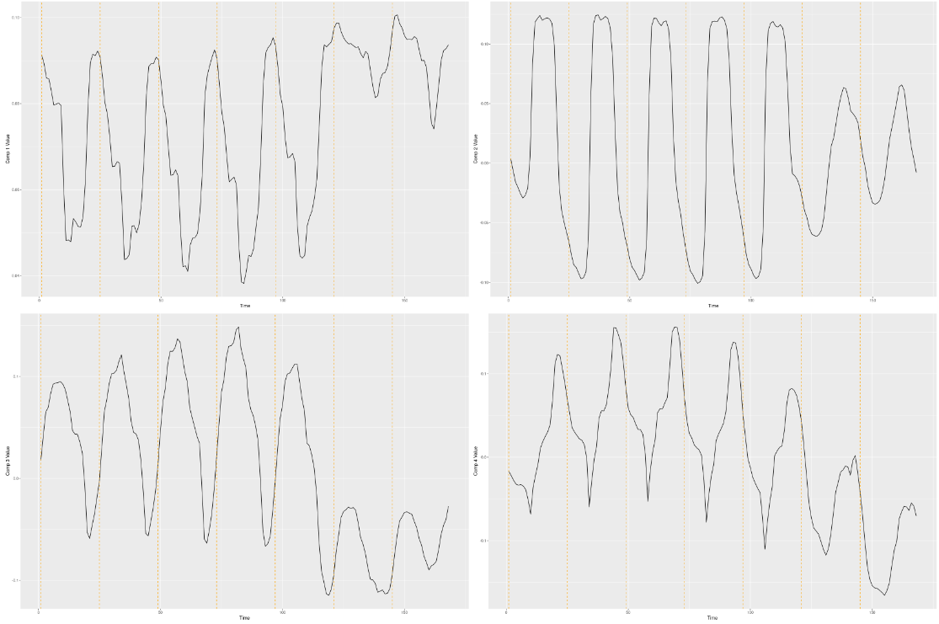
Interpretation of the components
1st:
2nd:
3rd:
4th:
Stations prominently losing bikes during the working day
Stations prominently receiving bikes during the working day
Hill stations
Redistribution of bikes
Notes:
Jonas

Slide 11
03
Clustering

Slide 12
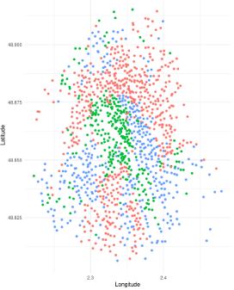
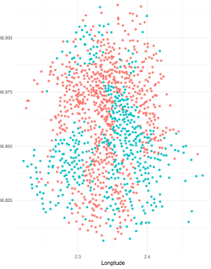
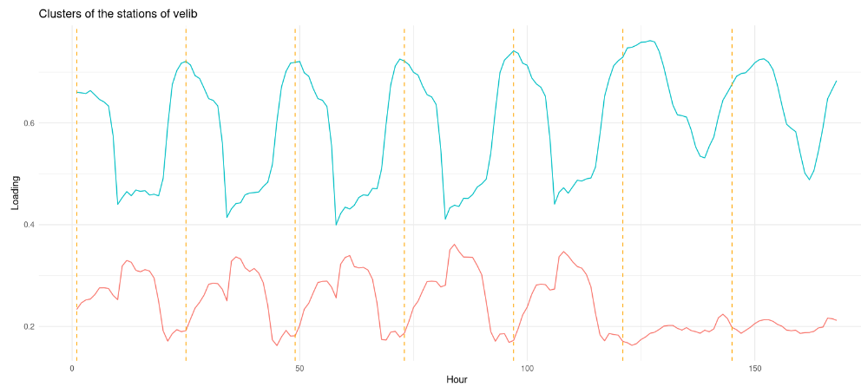
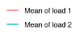


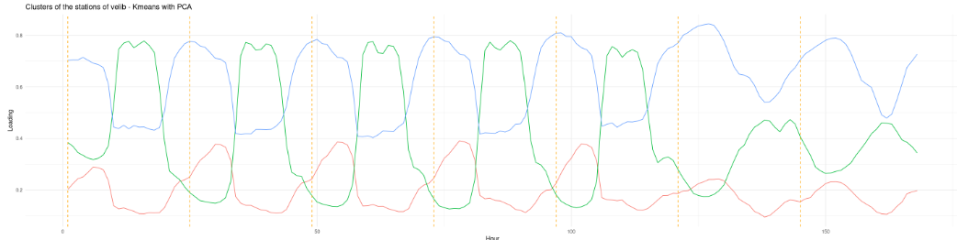
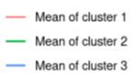
Kmeans
Original data
PCA
Stations on a hill : red line
Notes:
Kien

Slide 13
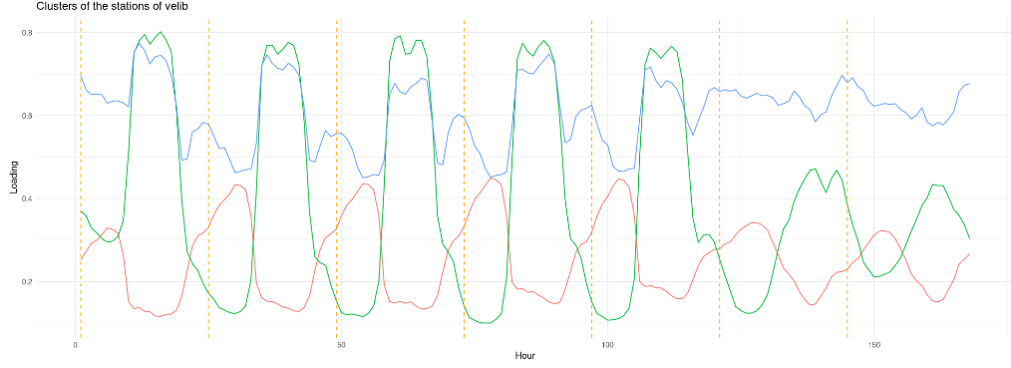
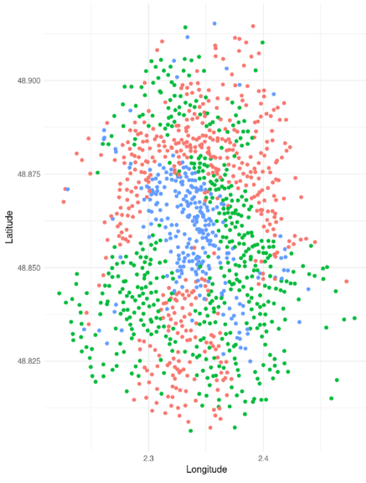
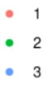
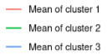

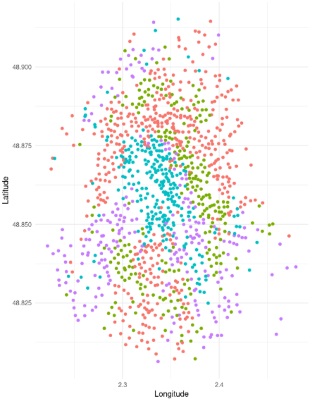
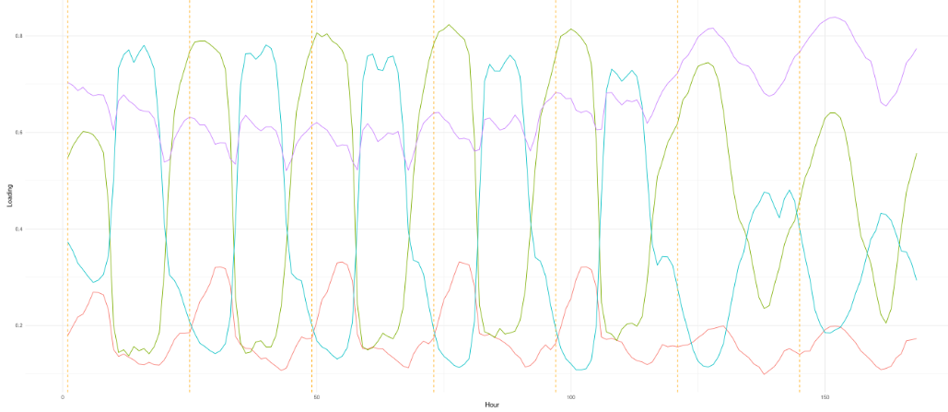
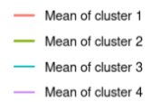
Hierarchical Agglomerative Clustering
Original data
PCA
Stations on a hill : red line
Notes:
Kien

Slide 14
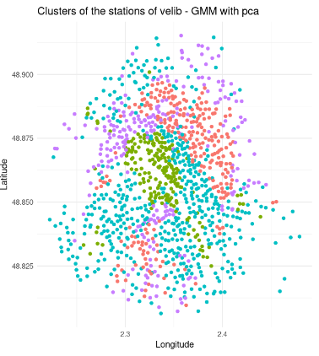

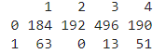
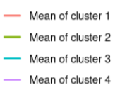
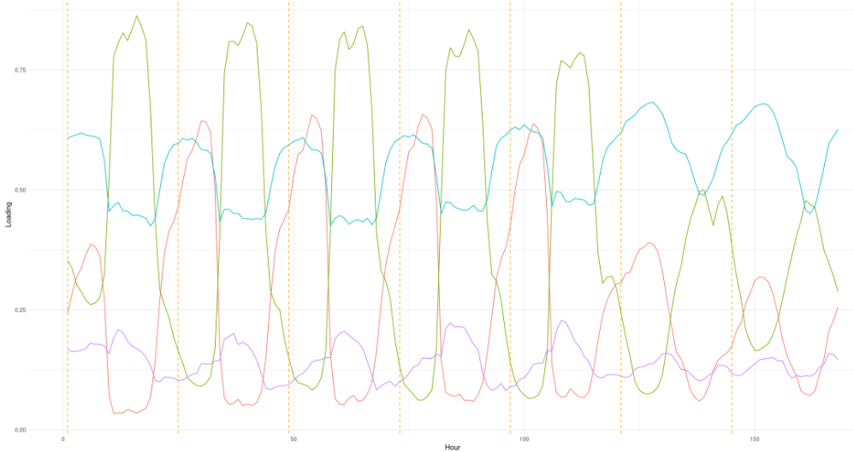
Gaussian Mixture Models
VVV cov. matrix
Not hill ->
Hill ->
Notes:
Jonas

Slide 15
Conclusion for quantitative clustering
# Clusters:
Kmeans: 2
AHC: 3
Kmeans (PCA): 3
AHC (PCA): 4
GMM (PCA): 4
Assigning of hill stations:
Kmeans: Same
AHC: Same
Kmeans (PCA): Same
AHC (PCA): Same
GMM (PCA): Three different
ARI | Kmeans | AHC | Kmeans (PCA) | AHC (PCA) | GMM (PCA)
Kmeans | 1 | 0.7947 | 0.5458 | - | -
AHC |  | 1 | - | 1 | -
Kmeans (PCA) |  |  | 1 | 0.7192 | 0.5058
AHC (PCA) |  |  |  | 1 | 0.2953
GMM (PCA) |  |  |  |  | 1
Notes:
Jonas

Slide 16
Multiple
Correspondance
Analysis
04

Slide 17
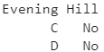
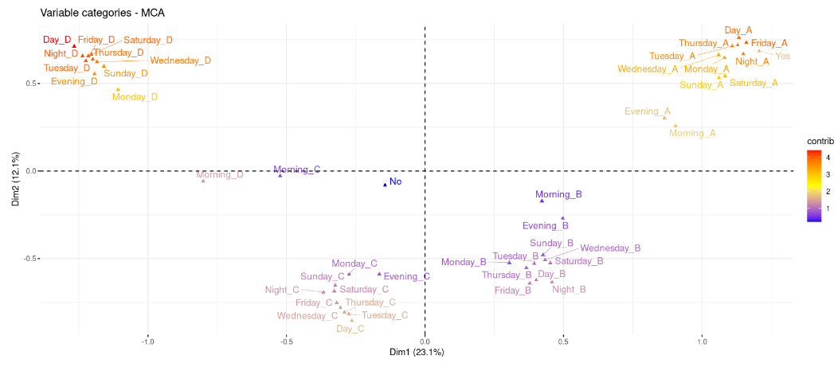
First dataframe
A-B-C-D : Categories created from the quartiles of each variable
First dimension : loading of the stations
Being on a hill : impact on the loading
Notes:
Elsa

Slide 18
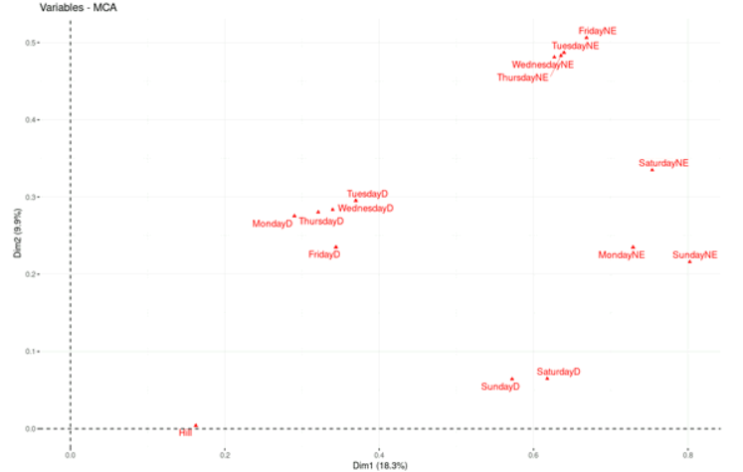
Second dataframe
First dimension : Loading
Second dimension: Day/Night
Weekdays and weekend still separated
Notes:
Elsa

Slide 19
05
Conclusion

Slide 20

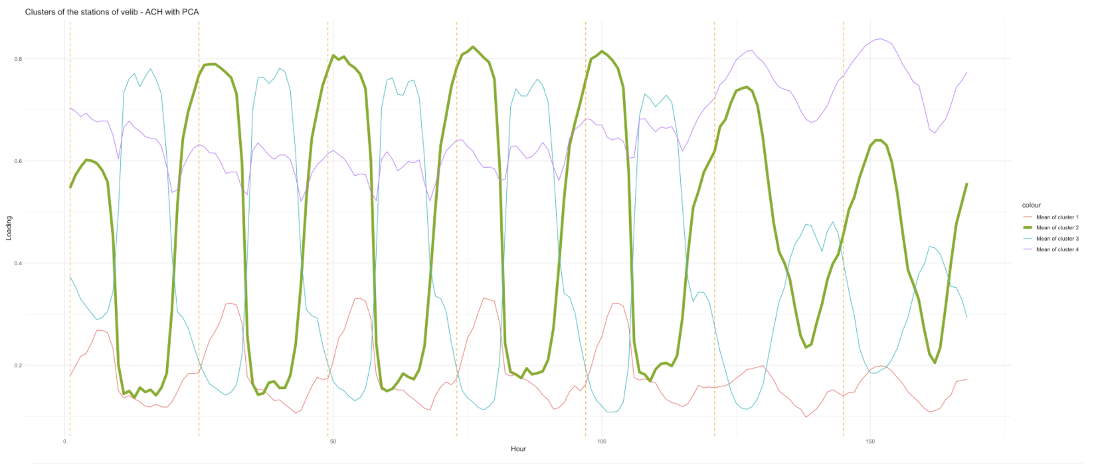
Where to open new stations?
https://www.southcoasttoday.com/story/lifestyle/2007/07/15/quickie-bike-rentals-make-it/52847851007/
Steep downfall around 8-10am
Low loading during the day

Slide 21
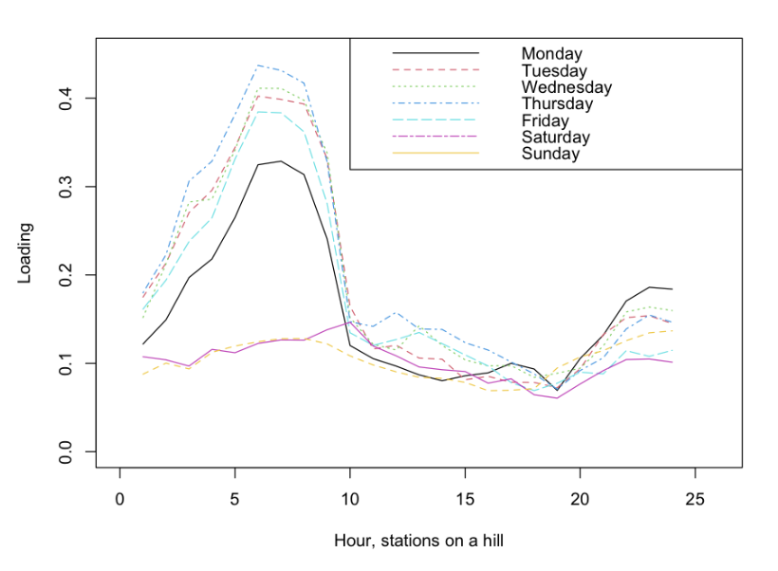

How can bikes be redistributed?
https://www.leparisien.fr/info-paris-ile-de-france-oise/transports/la-ville-de-paris-recupere-les-velib-egares-24-04-2018-7681821.php
Bikes can be moved using special trucks
Steep downfall during 8-10am but not much recovery in the afternoon

Slide 22


Self-distribute by users
By using MCA, we can further mark stations that are often empty
Encouraging redistributing to empty stations
https://www.voltage.fr/news/velib-rendre-son-velo-dans-une-station-pleine-n-est-plus-un-probleme-61201
Users redistribute bikes to high-altitude stations to get extra 15m-ride (Vélib, 2014)

Slide 23
Thanks!
Notes:
Kien

